Slide 1
Go for the Gold!
Current, Trendy, and Medal Winning
Content for Your Business Classroom
Jennifer Stubblefield
KBEA/SBEA Membership Director
KBEA President-Elect
Retired Business Teacher
Calloway County High School

Slide 2
Go for the Gold!
Current, Trendy, and Medal Winning
Content for Your Business Classroom
Jennifer Stubblefield
KBEA/SBEA Membership Director
KBEA President-elect
Retired Business Teacher
Calloway County High School

Slide 3
Relationship & Networking Time
Conference 101-you get get to know your fellow attendees! #priceless
Customer Success Manager
Certiport, Inc., A Pearson VUE Company, American Fork, Utah

Slide 4
What is different about business education’s content? (when compared to other fields)
While foundationally it stays the same, our content is in…
Constant Motion
Personally…that is one of the reasons
why I love what I teach!
Never a dull moment!

Slide 5
What happens if we don’t stay current and teach trends in the business world?
Who will ultimately be impacted?

Slide 6
So, how do we stay current?
Read/Watch/Listen
network
travel
Ask the end user
Subscribe, Podcasts, LinkedIn, The Morning Brew, Ted Talks, Social Media – Follow Movers and Shakers
Build Relationships, LinkedIn, Chamber of Commerce, FBLA
Attend Conferences, Personal Experiences, Field Trips, International, Strangers on Airplanes, Uber Drivers, B&B/AirBNB Business Owners
Local Business Owners, Former Students in the Corporate World, Parents in Business, Software Certifications
Commonality? You must put forth effort and TIME!

Slide 7
I’m ready! You ready?
Let’s look at current & trendy content
that we need to be adding to
ALL of our classrooms this year!
Two Methods:
I will share my research.
You are going to network and share out.

Slide 8
Digital Nomads
An employee who is categorized as remote/WFH and who is able to work anywhere there is wifi/connectivity.
The travel industry loves them and is specifically catering to their needs.
Special 30-day rates
High Speed Internet Bundles w/security
Meal Plans
It’s a win-win for business. Hotels, Airbnbs, resorts get long term guest to fill the rooms. Businesses have very happy employees with a fulfilled work/life balance.
The workplace is now, more than ever, where ever you are.
Content to teach: travel savvy, budgeting, self-control, time management, project management

Slide 9
Social Media Marketing, specifically Influencers
Like it or not, social media marketing better be a part of your content. You probably have students in your classes who are already experts at it anyway!
How it works: companies want someone who has tons of followers on SM to simply use their product, talk about their product, etc. And, companies are willing to pay people top dollar to do it!
Old School ways…ET eats Reese’s Pieces and IMMEDIATELY the product becomes a household name and frequent purchase.
New School ways…Kylie Jenner
New School ways…TBLF
Meet the students where they already are with assignments and projects regarding this topic!

Slide 10
Third-Party Delivery & Contactless is here to stay
If you would have told me three years ago that in Murray, KY I can have a Big Mac delivered to my door, I would have called you CRAZY!
Simply put, this is GOING no where and our future entrepreneurs had better be experts in it!
Make sure they know the big players (Door Dash, Uber Eats, Stitch-Fix, etc.) Use them as topics for projects, research, etc.
BOPUIS Stores who didn’t adapt to this model, well, they aren’t around in 2021 to talk about why they didn’t pivot!
The next big idea for this model may be sitting in your classroom. Ignite that flame with fun and unique assignments.

Slide 11
Your turn – let’s put our heads together!
Group Assignment
Name one concept that is new and trendy that we need to teach this year
Describe it briefly
Come up with a plan on how to teach it
Bell Ringers? Attention Getters?
Simulations?
They create a TikTok to teach the class about it?
Infographic?
Pick an influencer/social media marketing plan to promote the topic?
Friday Trivia Sessions?
Commercial Breaks to break up class time?

Slide 12
Other ideas as generated by the group while in Louisville
Upcycling Marketplace – Poshmark, ThreadUp, etc. A growing niche of business for extra income of personal items.
Virtual Reality Experiences – VR Entertainment, GoFan, etc. Businesses are seeing the interest in this area and will be missing the boat if they don’t get involved.
Subscription Boxes – HelloFresh, Stitch Fix, etc. Have students “think outside the box” for entrepreneurial ideas regarding subscription boxes that no one else has thought of.
MicroInvesting Apps – our students have got to understand the stock market, especially the rise in apps like Robinhood, Acorn, Stash.
Rebranding online with the help of resources like TeachTok, specifically how to use hashtags to turn your business around.
The dynamic world of Online Streaming – have students compare and contrast other streaming services and create a new one that meets a niche not already being met.

Slide 13
Links ready for you to read and learn more
https://www.forbes.com/sites/bernardmarr/2020/12/07/the-10-biggest-business-trends-for-2021-everyone-must-be-ready-for/
https://marketfinance.com/blog/industry-insight/2021/02/18/what-are-the-emerging-business-trends-for-2021
https://www.revlocal.com/resources/library/blog/these-are-the-most-important-buzzwords-of-2021
https://www.forbes.com/sites/theyec/2019/10/10/are-social-media-influencers-worth-the-investment/

Slide 14
“Just five more minutes”
Your students NEED you to spend time WITH THEM and also preparing content FOR THEM!
I wish you the best in BOTH endeavors this year!
“They won’t care how much you know, until they know
how much you care.”

Slide 15
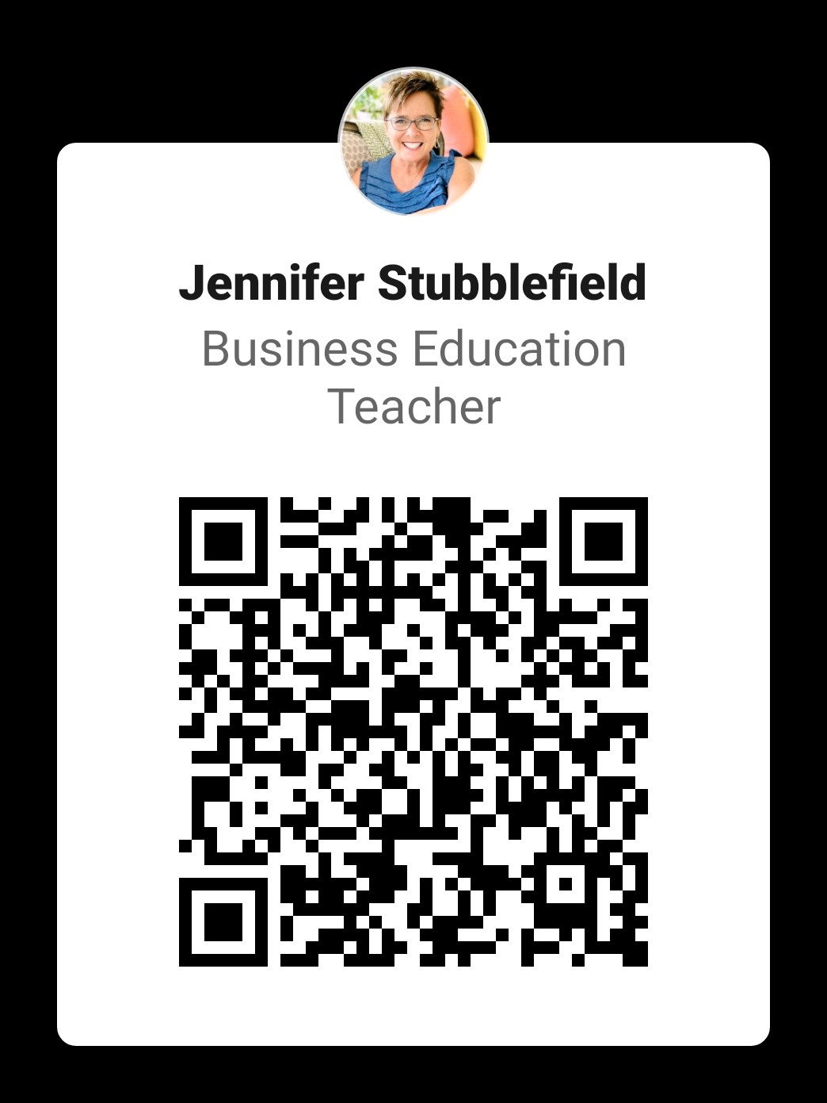
Let’s connect!

Slide 16
Thank you!
jennifer.stubblefield@pearson.com
www.jenniferstubblefield.biz
Jennifer_stubb

